Slide 1
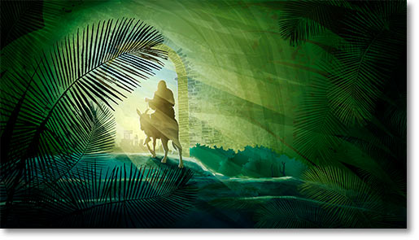
Welcome to St Margaret’s Ifield
11am 5th April 2020
The First Sunday Service
PALM SUNDAY
This Photo by Unknown Author is licensed under CC BY-SA-NC

Slide 2
WELCOME
All: Hosanna to the Son of David, the king of Israel. Blessed is he who comes in the name of the Lord. Hosanna in the highest.
Please hold up Your palms - Blessing of Palms Video
Celebrant: The Lord be with you.
All: And also with you.

Slide 3
Celebrant:
Dear friends in Christ, during Lent we have been preparing by works of love and self-sacrifice for the celebration of our Lord’s death and resurrection. Today we come together to begin this solemn celebration in union with the Church throughout the world. Christ enters his own city to complete his work as our Saviour, to suffer, to die, and to rise again. Let us go with him in faith and love, so that, united with him in his sufferings, we may share his risen life.

Slide 4
Celebrant:
God our Saviour, whose Son Jesus Christ entered Jerusalem as Messiah to suffer and to die, let these palms be for us signs of his victory; and grant that we who bear them in his name may ever hail him as our King, and follow him in the way that lead to eternal life: who lives and reigns with you and the Holy Spirit, now and for ever. Amen.
GOSPEL Matthew 21:1-11 (NRSV Ang)
Celebrant: This is the Gospel of the Lord
ALL: Praise to You O Christ

Slide 5
Lenten Candle Liturgy – Video
The red and white candles on the Lenten Wreath are lit
Leader: We have gathered here, week after week, sharing a common quest for a deeper faith and a deeper experience of the divine. I invite you now to close your eyes and let go of the things that distract and concern you. Listen! The time is drawing near. Jesus is preparing to enter Jerusalem. How will we greet him? Will we follow him all the way to the Cross? The power of Jesus is that he lived what he taught, even when it led to his death. He lived with an abiding awareness of God, radiating the light of God in all he said and did. But that light was too much for the world. There are forces today, as there were in ancient Judea, that conspire to put it out. Where are we in this drama? What are we willing to risk to follow Jesus?

Slide 6
(Silent time)
As we extinguish this light, we acknowledge the darkness and pain of illness and disease in the world.
(The red candle is extinguished)
Let us pray.
All: Loving God, there are so many choices before us every day. Choices offered by our friends, our families, our culture, our own past. Some of them encourage the well-being of the earth, ourselves and our neighbours; others are destructive. Help us to distinguish between them. May we learn from the choices of Jesus and embody compassion, justice, and inclusion in all we say and do. Amen.

Slide 7
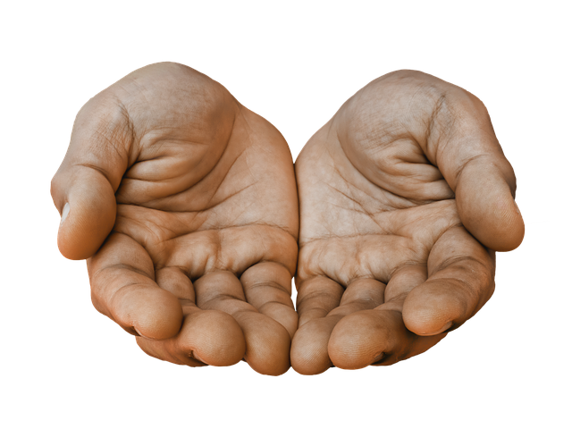
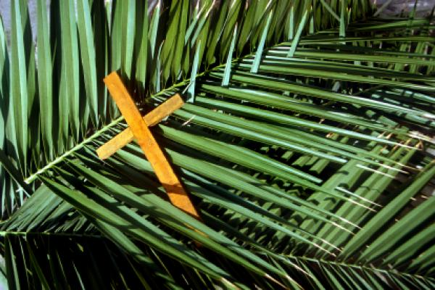
INTRODUCTION
AUDIO OF READING (On screen as well)
Matthew 26:14 - 27:66 (NRSV Ang)
TALK INTRODUCTION

Slide 8
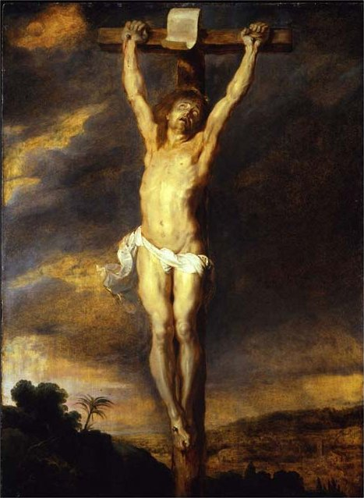

Slide 9
SAYING SORRY TO GOD
Leader: Lord Jesus, you came to change the world.
All: Forgive us when we become complacent, when change is
difficult – and we give up.
Leader: Lord Jesus, you came to serve, not to be served.
All: Forgive us when we put ourselves and our needs before those of our brothers and sisters.
Leader: Lord Jesus, you came to set the captives free.
All: Forgive us when we don’t stand up for justice and freedom for our neighbours.

Slide 10
Leader: Lord Jesus, you came to meet us where we are.
All: Forgive us when we don’t stand with each other through the pain and struggle.
Leader: Help us to change the world by serving one another, standing up for justice, and walking with our fellow pilgrims.
All: Amen.
Leader: May the God of love
Forgive us and free us from our sins,
Heal and strengthen us by his Spirit,
And raise us to new life in Christ our Lord.
All: Amen.

Slide 11
WE BELIEVE
All: We believe that God is our Father in heaven,
We believe He made the world
We believe that He gives us life,
We believe that He helps us grow.
We believe that Jesus is the Son of God and the Son of Mary.
Jesus shows us that God is love;
Jesus lived and died for us.
Jesus is alive now, alive in us and in our neighbour.
We believe in the Holy Spirit who helps us to love others,
who makes us holy, who helps us know God better.
We believe in God’s family the Church.
We believe that we will be happy with God forever and ever. Amen.

Slide 12
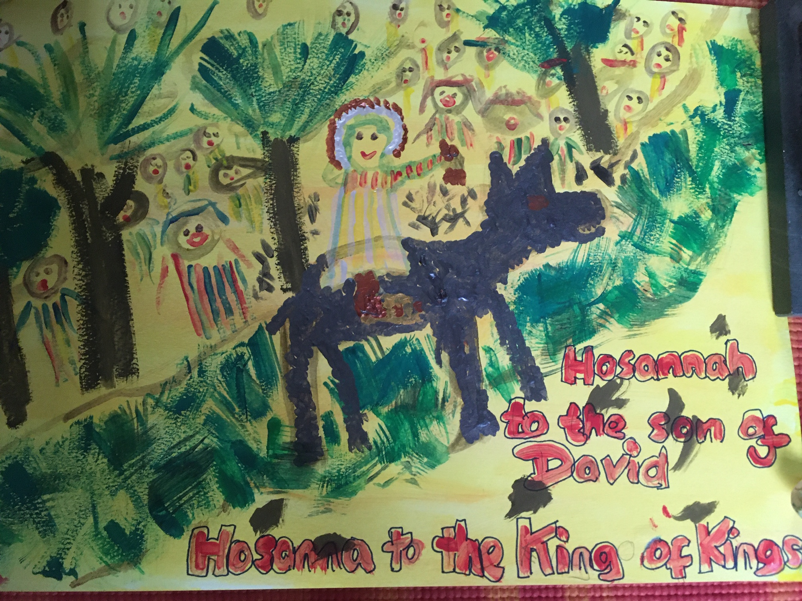

Slide 13
THE LORD’S PRAYER
All: Our Father in heaven,
hallowed be your name, your kingdom come,
your will be done, on earth as in heaven. Give us today our daily bread. Forgive us our sins as we forgive those who sin against us. Lead us not into temptation but deliver us from evil. For the kingdom, the power, and the glory are yours now and for ever. Amen.

Slide 14
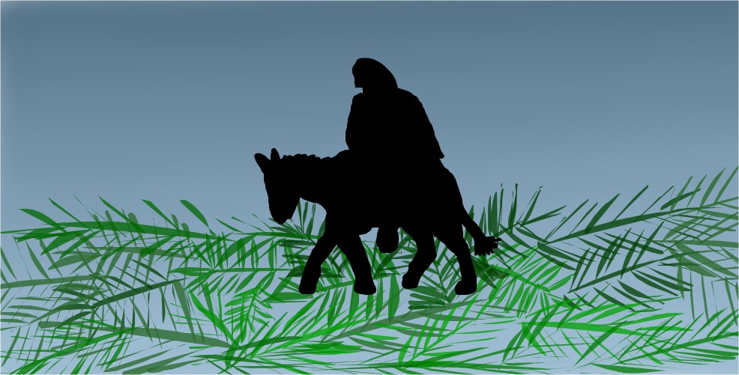
THE BLESSING
Leader: As we go our separate ways, let us celebrate the King, the
Liberator, the Servant, the One who caused disturbance.
All: And let us be ready to do the same. Amen.

Slide 15
Thank you for sharing in this worship.
May the peace of Jesus be in your hearts, and may you be nourished
for the Holy Week ahead.
Please do keep looking at the parish website. Details of the readings
for Maundy Thursday and Easter Day will be there.
You will also be able to access the Good Friday Meditation, Easter
FIISH, and Roger Combes’ reflection for Easter Day.
We would welcome your feedback on this service. Please speak to any
member of the First Sunday Team, or email reader@ifieldparish.org

Slide 16
We want you to know that you are... 'Loved as you are'
​
The St Margaret’s Church family is here to help you.
​
For pastoral support:
Please ring or text: 07401 217648
or email pastoral@ifieldparish.org
​
For any other support:
Please ring or text: 07401 213932
or email community@ifieldparish.org
-------------------------------------------------------
Calamus Licence No: 95 C.C.L. Licence No: 210222
The service material in this booklet is taken from Common Worship.
© Copyright 2000 The Archbishop’s Council

